Slide 1
Host provisioning and configuration Management
Getting started with Cobbler and Puppet

Slide 2

XSEDE
XSEDE is a single virtual system that scientists can use to interactively share computing resources, data and expertise. People around the world use these resources and services — things like supercomputers, collections of data and new tools — to improve our planet.
Please go to https://www.xsede.org/ and register
After you register, send me your XSEDE ID so I can add you to our project

Slide 3
Two new Linux Commands
find - Used to look for a file in the a directory tree
grep - Used to search for a string in a file
Both commands are powerful and have many options:
find [options] start-point [expressions] Example:find /usr/bin find /usr/bin -name passwd find /usr/bin -name ‘*wd*’
grep [OPTIONS] PATTERN [FILE...]
Example: grep student /etc/passwd grep student /etc/*
WARNING: Using grep on non-ASCII files can print control characters to the screen
grep -a a /usr/bin/passwd

Slide 4
Clicker question:
XSEDE is:
A new energy drink
A method to optimize C++ code
New Physics where particles travel faster than light
A large USA computing infrastructure
New Genetic Algorithm

Slide 5
Clicker question
grep:
Global Regular Expression Parser
Searches for strings in files
Was written by Linus Torvalds
A, B and C are true
Only A and B are True

Slide 6
Course outline
There is now a rough course outline in the Google Folder
It will be an evolving document. I will try to update it and add details as the class progresses.
Please check the folder often
I will probably work on it daily

Slide 7
Provisioning
Provisioning is the process of initially installing the operating system on the hardware.
This could be done on one machine by one as you did on the first node, but this becomes impractical as the number of nodes increases.
If it takes you 10 minutes to provision one machine with a USB and you have to provision 500 machines, this will take you 5000 minutes.
How many hours is that?
How many days.
What happens when you want to change the configuration?
Are you certain to configure all machines identically?

Slide 8
Provisioning tools
There are a number of different tools that can be using for provisioning. Please take a look at:
https://www.cyberciti.biz/tips/server-provisioning-software.html
We will be using Cobbler
Cobbler does have a GUI
We will learn about the command line first

Slide 9
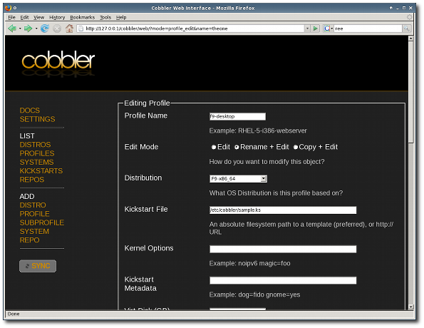

Slide 10
Overview of Linux Provisioning
Almost all Linux provisioning systems use the low level technology PXEBOOT
PXEBOOT - In computing, the Preboot eXecution Environment (PXE, sometimes pronounced as pixie) specification describes a standardized client-server environment that boots a software assembly, retrieved from a network, on PXE-enabled clients. On the client side it requires only a PXE-capable network interface controller (NIC), and uses a small set of industry-standard network protocols such as DHCP and TFTP. (Wikipedia Article about PXE)
DHCP - Dynamic Host Configuration Protocol
TFTP - Trivial File Transfer Protocol

Slide 11
Process of PXE Booting
Client is powered up and sends a network request for boot instructions
Server responds that it able to help client boot, get IP address, etc
Client contacts DHCP server for IP address
Client receives IP address from DHCP server
Client receives Boot File from PXE boot server
Client boots the image and begins to the execute instructions in the image
Boot image can include any instructions that the hardware understands

Slide 12
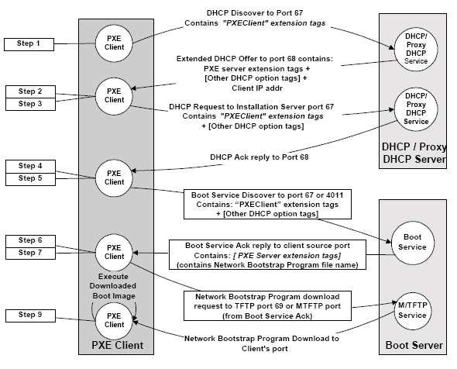
PXE Boot Sequence

Slide 13
Clicker Question
The WWW was created by:
Bill Gates
Richard Stallman
Sir Tim Berners-Lee
Steve Jobs
Albert Einstein

Slide 14
Clicker question:
Can the PXE Boot server send images that do things other than install an operating system?
True
False
I am not sure
I am completely lost

Slide 15
Components to your mini cluster
htc180.najah.edu
htc182.najah.edu
cobbler server
htc190.najah.edu
htc183.najah.edu
cobbler client
htc191.najah.edu
This is a logical component diagram
This is not a network diagram

Slide 16
Thank you to the following people
Salsabeel Ahmad Taha
Mohammad Tayseer Abdulhaq
Maysoon Ashayer
Thana' Mer'i
Isra Hinnawi
Tasneem Abu-Eideh
Now it is my job to learn your names
I apologize for how difficult this is for me
I ask for your help

